Slide 1
CTO4Startup Knowledge of coding
Matteo Pagani
Windows AppConsult Engineer
matteo.pagani@microsoft.com
Twitter: @qmatteoq
Notes:
IMPORTANT NOTES:
TechReady24 will utilize Windows 10 and the new PowerPoint 2016, as well as PowerPoint 2013 on all event machines. Please build your slides utilizing the appropriate TR24 Template and utilize the version of PowerPoint that works best.
Windows 10 devices now connect remotely through VPN using the PIN with Passport for Work. Speakers needing to use VPN in a demo, will need to have registered for Phone Authentication at https://phoneregistration.microsoft.com. Additional details are also available here: https://microsoft.sharepoint.com/sites/itweb/securelogon/Pages/FAQ.aspx

Slide 2
Agenda
Why coding?
Languages, platforms, tools
Coding in the Microsoft world

Slide 3
Why coding?
Coding is the heart of every technology
Mobile, web, desktop, cloud, Internet of Things, artificial intelligence…
Multiple platforms, multiple tools, multiple goals, one common language: coding
Knowing the basics of coding is becoming more and more essential, because technology is everywhere
Notes:
This slide is required. Do NOT delete. This should be the first slide after your Title Slide. This is an important year and we need to arm our attendees with the information they can use to Grow Share! Please ensure that your objectives are SMART (defined below) and that they will enable them to go in and win against the competition to grow share. If you have questions, please contact your Track PM for guidance. We have also posted guidance on writing good objectives, out on the Speaker Portal (https://www.mytechready.com).
This slide should introduce the session by identifying how this information helps the attendee, partners and customers be more successful. Why is this content important?
This slide should call out what’s important about the session (sort of the why should we care, why is this important and how will it help our customers/partners be successful) as well as the key takeaways/objectives associated with the session. Call out what attendees will be able to execute on using the information gained in this session. What will they be able to walk away from this session and execute on with their customers.
Good Objectives should be SMART (specific, measurable, achievable, realistic, time-bound). Focus on the key takeaways and why this information is important to the attendee, our partners and our customers.
Each session has objectives defined and published on www.mytechready.com, please work with your Track PM to call these out here in the slide deck.
If you have questions, please contact your Track PM. See slide 5 in this template for a complete list of Tracks and TPMs.

Slide 4
Languages
Languages are different dialects to code
Each language has its own syntax, its own features and, usually, it’s also tight to as specific platform or to a specific context
Languages keep evolving over time, some disappears, new ones start to grow
Notes:
This slide is required. Do NOT delete. This should be the first slide after your Title Slide. This is an important year and we need to arm our attendees with the information they can use to Grow Share! Please ensure that your objectives are SMART (defined below) and that they will enable them to go in and win against the competition to grow share. If you have questions, please contact your Track PM for guidance. We have also posted guidance on writing good objectives, out on the Speaker Portal (https://www.mytechready.com).
This slide should introduce the session by identifying how this information helps the attendee, partners and customers be more successful. Why is this content important?
This slide should call out what’s important about the session (sort of the why should we care, why is this important and how will it help our customers/partners be successful) as well as the key takeaways/objectives associated with the session. Call out what attendees will be able to execute on using the information gained in this session. What will they be able to walk away from this session and execute on with their customers.
Good Objectives should be SMART (specific, measurable, achievable, realistic, time-bound). Focus on the key takeaways and why this information is important to the attendee, our partners and our customers.
Each session has objectives defined and published on www.mytechready.com, please work with your Track PM to call these out here in the slide deck.
If you have questions, please contact your Track PM. See slide 5 in this template for a complete list of Tracks and TPMs.

Slide 5
Object oriented programming
It’s the most widely used programming approach nowadays
The name comes from the fact that it’s based on the concept of objects, which can expose:
Data, using attributes
Code and logic, using methods
A class is the definition of an object
An object is an instance of class
Notes:
This slide is required. Do NOT delete. This should be the first slide after your Title Slide. This is an important year and we need to arm our attendees with the information they can use to Grow Share! Please ensure that your objectives are SMART (defined below) and that they will enable them to go in and win against the competition to grow share. If you have questions, please contact your Track PM for guidance. We have also posted guidance on writing good objectives, out on the Speaker Portal (https://www.mytechready.com).
This slide should introduce the session by identifying how this information helps the attendee, partners and customers be more successful. Why is this content important?
This slide should call out what’s important about the session (sort of the why should we care, why is this important and how will it help our customers/partners be successful) as well as the key takeaways/objectives associated with the session. Call out what attendees will be able to execute on using the information gained in this session. What will they be able to walk away from this session and execute on with their customers.
Good Objectives should be SMART (specific, measurable, achievable, realistic, time-bound). Focus on the key takeaways and why this information is important to the attendee, our partners and our customers.
Each session has objectives defined and published on www.mytechready.com, please work with your Track PM to call these out here in the slide deck.
If you have questions, please contact your Track PM. See slide 5 in this template for a complete list of Tracks and TPMs.

Slide 6
Object oriented programming
Class
public class Person
{
public string Name { get; set; }
public string Surname { get; set; }
public string SayHello()
{
return "Hello my friend!";
}
}
Object
Person person = new Person();
string message = person.SayHello();
Notes:
This slide is required. Do NOT delete. This should be the first slide after your Title Slide. This is an important year and we need to arm our attendees with the information they can use to Grow Share! Please ensure that your objectives are SMART (defined below) and that they will enable them to go in and win against the competition to grow share. If you have questions, please contact your Track PM for guidance. We have also posted guidance on writing good objectives, out on the Speaker Portal (https://www.mytechready.com).
This slide should introduce the session by identifying how this information helps the attendee, partners and customers be more successful. Why is this content important?
This slide should call out what’s important about the session (sort of the why should we care, why is this important and how will it help our customers/partners be successful) as well as the key takeaways/objectives associated with the session. Call out what attendees will be able to execute on using the information gained in this session. What will they be able to walk away from this session and execute on with their customers.
Good Objectives should be SMART (specific, measurable, achievable, realistic, time-bound). Focus on the key takeaways and why this information is important to the attendee, our partners and our customers.
Each session has objectives defined and published on www.mytechready.com, please work with your Track PM to call these out here in the slide deck.
If you have questions, please contact your Track PM. See slide 5 in this template for a complete list of Tracks and TPMs.

Slide 7
Compiled programming languages
A compiler takes care of converting the programming language into machine code
Faster execution and performances
Tight connection with the platform, the architecture and the hardware
More complex to handle cross platform and cross architecture scenarios
Low level languages, you need to know many inner details of how a computer works
Notes:
This slide is required. Do NOT delete. This should be the first slide after your Title Slide. This is an important year and we need to arm our attendees with the information they can use to Grow Share! Please ensure that your objectives are SMART (defined below) and that they will enable them to go in and win against the competition to grow share. If you have questions, please contact your Track PM for guidance. We have also posted guidance on writing good objectives, out on the Speaker Portal (https://www.mytechready.com).
This slide should introduce the session by identifying how this information helps the attendee, partners and customers be more successful. Why is this content important?
This slide should call out what’s important about the session (sort of the why should we care, why is this important and how will it help our customers/partners be successful) as well as the key takeaways/objectives associated with the session. Call out what attendees will be able to execute on using the information gained in this session. What will they be able to walk away from this session and execute on with their customers.
Good Objectives should be SMART (specific, measurable, achievable, realistic, time-bound). Focus on the key takeaways and why this information is important to the attendee, our partners and our customers.
Each session has objectives defined and published on www.mytechready.com, please work with your Track PM to call these out here in the slide deck.
If you have questions, please contact your Track PM. See slide 5 in this template for a complete list of Tracks and TPMs.

Slide 8
Interpreted programming languages
High level languages, which abstract most of the inner details of how a computer works
The code is executed directly at runtime, without being directly compiled into machine code
The execution of the code was directly performed by an interpreter, like an old browser for applications built with JavaScript
Notes:
This slide is required. Do NOT delete. This should be the first slide after your Title Slide. This is an important year and we need to arm our attendees with the information they can use to Grow Share! Please ensure that your objectives are SMART (defined below) and that they will enable them to go in and win against the competition to grow share. If you have questions, please contact your Track PM for guidance. We have also posted guidance on writing good objectives, out on the Speaker Portal (https://www.mytechready.com).
This slide should introduce the session by identifying how this information helps the attendee, partners and customers be more successful. Why is this content important?
This slide should call out what’s important about the session (sort of the why should we care, why is this important and how will it help our customers/partners be successful) as well as the key takeaways/objectives associated with the session. Call out what attendees will be able to execute on using the information gained in this session. What will they be able to walk away from this session and execute on with their customers.
Good Objectives should be SMART (specific, measurable, achievable, realistic, time-bound). Focus on the key takeaways and why this information is important to the attendee, our partners and our customers.
Each session has objectives defined and published on www.mytechready.com, please work with your Track PM to call these out here in the slide deck.
If you have questions, please contact your Track PM. See slide 5 in this template for a complete list of Tracks and TPMs.

Slide 9
Best of both worlds
Techniques like JIT (Just-In-Time) can help to get the best of both worlds
The high level language is compiled into an intermediate language, which then is translated into machine code at runtime
Examples:
C# -> Intermediate Language -> Machine language thanks to the CLR
Java -> Byte code -> Machine language thanks to the Java Virtual Machine or Android Runtime (in case of mobile apps)
Notes:
This slide is required. Do NOT delete. This should be the first slide after your Title Slide. This is an important year and we need to arm our attendees with the information they can use to Grow Share! Please ensure that your objectives are SMART (defined below) and that they will enable them to go in and win against the competition to grow share. If you have questions, please contact your Track PM for guidance. We have also posted guidance on writing good objectives, out on the Speaker Portal (https://www.mytechready.com).
This slide should introduce the session by identifying how this information helps the attendee, partners and customers be more successful. Why is this content important?
This slide should call out what’s important about the session (sort of the why should we care, why is this important and how will it help our customers/partners be successful) as well as the key takeaways/objectives associated with the session. Call out what attendees will be able to execute on using the information gained in this session. What will they be able to walk away from this session and execute on with their customers.
Good Objectives should be SMART (specific, measurable, achievable, realistic, time-bound). Focus on the key takeaways and why this information is important to the attendee, our partners and our customers.
Each session has objectives defined and published on www.mytechready.com, please work with your Track PM to call these out here in the slide deck.
If you have questions, please contact your Track PM. See slide 5 in this template for a complete list of Tracks and TPMs.

Slide 10
Compilers
Compilers, in the modern world, are often not just translators from one language to another, but they offer an infrastructure (like the Common Language Infrastructure in .NET) which add:
Improved security
Easier memory management (garbage collection)
Easier exceptions handling
Interoperability
Notes:
This slide is required. Do NOT delete. This should be the first slide after your Title Slide. This is an important year and we need to arm our attendees with the information they can use to Grow Share! Please ensure that your objectives are SMART (defined below) and that they will enable them to go in and win against the competition to grow share. If you have questions, please contact your Track PM for guidance. We have also posted guidance on writing good objectives, out on the Speaker Portal (https://www.mytechready.com).
This slide should introduce the session by identifying how this information helps the attendee, partners and customers be more successful. Why is this content important?
This slide should call out what’s important about the session (sort of the why should we care, why is this important and how will it help our customers/partners be successful) as well as the key takeaways/objectives associated with the session. Call out what attendees will be able to execute on using the information gained in this session. What will they be able to walk away from this session and execute on with their customers.
Good Objectives should be SMART (specific, measurable, achievable, realistic, time-bound). Focus on the key takeaways and why this information is important to the attendee, our partners and our customers.
Each session has objectives defined and published on www.mytechready.com, please work with your Track PM to call these out here in the slide deck.
If you have questions, please contact your Track PM. See slide 5 in this template for a complete list of Tracks and TPMs.

Slide 11
Loosely-typed languages
All the code is evaluated at runtime
They are often called as “scripting languages”
JavaScript and Python are probably the most famous ones
A type is associated with each value, which means that the same variable can assume multiple types during execution
Notes:
This slide is required. Do NOT delete. This should be the first slide after your Title Slide. This is an important year and we need to arm our attendees with the information they can use to Grow Share! Please ensure that your objectives are SMART (defined below) and that they will enable them to go in and win against the competition to grow share. If you have questions, please contact your Track PM for guidance. We have also posted guidance on writing good objectives, out on the Speaker Portal (https://www.mytechready.com).
This slide should introduce the session by identifying how this information helps the attendee, partners and customers be more successful. Why is this content important?
This slide should call out what’s important about the session (sort of the why should we care, why is this important and how will it help our customers/partners be successful) as well as the key takeaways/objectives associated with the session. Call out what attendees will be able to execute on using the information gained in this session. What will they be able to walk away from this session and execute on with their customers.
Good Objectives should be SMART (specific, measurable, achievable, realistic, time-bound). Focus on the key takeaways and why this information is important to the attendee, our partners and our customers.
Each session has objectives defined and published on www.mytechready.com, please work with your Track PM to call these out here in the slide deck.
If you have questions, please contact your Track PM. See slide 5 in this template for a complete list of Tracks and TPMs.

Slide 12
Strongly-typed languages
The code is first precompiled before being executed at runtime
Syntax errors are identified ahead of compiling the code
Less flexibility, but less chances of errors
You must declare in advance a variable’s type and it can’t change during execution
Notes:
This slide is required. Do NOT delete. This should be the first slide after your Title Slide. This is an important year and we need to arm our attendees with the information they can use to Grow Share! Please ensure that your objectives are SMART (defined below) and that they will enable them to go in and win against the competition to grow share. If you have questions, please contact your Track PM for guidance. We have also posted guidance on writing good objectives, out on the Speaker Portal (https://www.mytechready.com).
This slide should introduce the session by identifying how this information helps the attendee, partners and customers be more successful. Why is this content important?
This slide should call out what’s important about the session (sort of the why should we care, why is this important and how will it help our customers/partners be successful) as well as the key takeaways/objectives associated with the session. Call out what attendees will be able to execute on using the information gained in this session. What will they be able to walk away from this session and execute on with their customers.
Good Objectives should be SMART (specific, measurable, achievable, realistic, time-bound). Focus on the key takeaways and why this information is important to the attendee, our partners and our customers.
Each session has objectives defined and published on www.mytechready.com, please work with your Track PM to call these out here in the slide deck.
If you have questions, please contact your Track PM. See slide 5 in this template for a complete list of Tracks and TPMs.

Slide 13
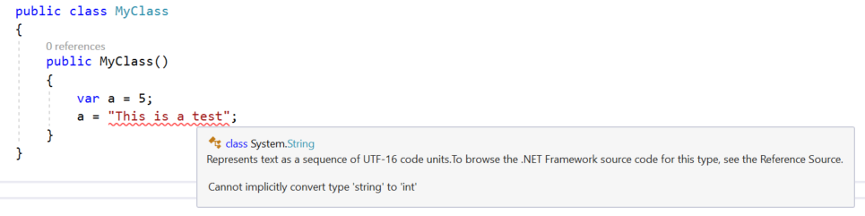
Examples
JavaScript
<script type="text/javascript">
var a = 5;
a = "This is a test;"
</script>
C#
Notes:
This slide is required. Do NOT delete. This should be the first slide after your Title Slide. This is an important year and we need to arm our attendees with the information they can use to Grow Share! Please ensure that your objectives are SMART (defined below) and that they will enable them to go in and win against the competition to grow share. If you have questions, please contact your Track PM for guidance. We have also posted guidance on writing good objectives, out on the Speaker Portal (https://www.mytechready.com).
This slide should introduce the session by identifying how this information helps the attendee, partners and customers be more successful. Why is this content important?
This slide should call out what’s important about the session (sort of the why should we care, why is this important and how will it help our customers/partners be successful) as well as the key takeaways/objectives associated with the session. Call out what attendees will be able to execute on using the information gained in this session. What will they be able to walk away from this session and execute on with their customers.
Good Objectives should be SMART (specific, measurable, achievable, realistic, time-bound). Focus on the key takeaways and why this information is important to the attendee, our partners and our customers.
Each session has objectives defined and published on www.mytechready.com, please work with your Track PM to call these out here in the slide deck.
If you have questions, please contact your Track PM. See slide 5 in this template for a complete list of Tracks and TPMs.

Slide 14
Which is the Microsoft story for developers?

Slide 15
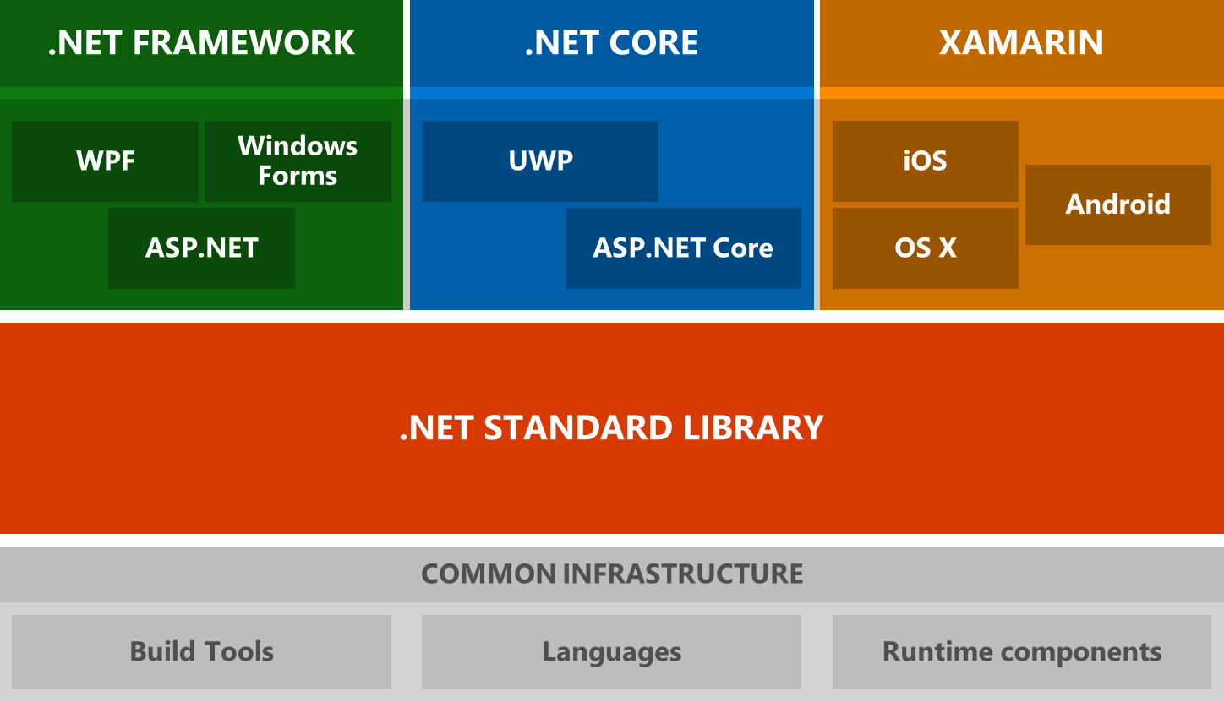
Notes:
This slide is required. Do NOT delete. This should be the first slide after your Title Slide. This is an important year and we need to arm our attendees with the information they can use to Grow Share! Please ensure that your objectives are SMART (defined below) and that they will enable them to go in and win against the competition to grow share. If you have questions, please contact your Track PM for guidance. We have also posted guidance on writing good objectives, out on the Speaker Portal (https://www.mytechready.com).
This slide should introduce the session by identifying how this information helps the attendee, partners and customers be more successful. Why is this content important?
This slide should call out what’s important about the session (sort of the why should we care, why is this important and how will it help our customers/partners be successful) as well as the key takeaways/objectives associated with the session. Call out what attendees will be able to execute on using the information gained in this session. What will they be able to walk away from this session and execute on with their customers.
Good Objectives should be SMART (specific, measurable, achievable, realistic, time-bound). Focus on the key takeaways and why this information is important to the attendee, our partners and our customers.
Each session has objectives defined and published on www.mytechready.com, please work with your Track PM to call these out here in the slide deck.
If you have questions, please contact your Track PM. See slide 5 in this template for a complete list of Tracks and TPMs.

Slide 16
.NET Framework
It’s the historical framework, launched in 2002, with the goal to make the development platform independent from the Windows version
Its purpose is to create server and client apps that run on Windows (ASP.NET, Windows Forms, WPF, etc.)
It contains, other than the base class library, many Windows specific APIs
Notes:
This slide is required. Do NOT delete. This should be the first slide after your Title Slide. This is an important year and we need to arm our attendees with the information they can use to Grow Share! Please ensure that your objectives are SMART (defined below) and that they will enable them to go in and win against the competition to grow share. If you have questions, please contact your Track PM for guidance. We have also posted guidance on writing good objectives, out on the Speaker Portal (https://www.mytechready.com).
This slide should introduce the session by identifying how this information helps the attendee, partners and customers be more successful. Why is this content important?
This slide should call out what’s important about the session (sort of the why should we care, why is this important and how will it help our customers/partners be successful) as well as the key takeaways/objectives associated with the session. Call out what attendees will be able to execute on using the information gained in this session. What will they be able to walk away from this session and execute on with their customers.
Good Objectives should be SMART (specific, measurable, achievable, realistic, time-bound). Focus on the key takeaways and why this information is important to the attendee, our partners and our customers.
Each session has objectives defined and published on www.mytechready.com, please work with your Track PM to call these out here in the slide deck.
If you have questions, please contact your Track PM. See slide 5 in this template for a complete list of Tracks and TPMs.

Slide 17
.NET Core
It’s the new runtime launched by Microsoft to face the new challenges of the modern world:
It’s cross-platform: it runs on Windows, Linux and OS X
It’s open source using MIT and Apache2 licenses
Its CLR can be installed machine-wide, user-wide or deployed app per app
It’s currently leveraged by three platforms:
Console applications
ASP.NET Core: to create server side web app and services
Universal Windows Platform: to create new and modern applications that can run on every Windows 10 device (computers, tablets, phones, IoT devices, HoloLens, etc.)
Notes:
This slide is required. Do NOT delete. This should be the first slide after your Title Slide. This is an important year and we need to arm our attendees with the information they can use to Grow Share! Please ensure that your objectives are SMART (defined below) and that they will enable them to go in and win against the competition to grow share. If you have questions, please contact your Track PM for guidance. We have also posted guidance on writing good objectives, out on the Speaker Portal (https://www.mytechready.com).
This slide should introduce the session by identifying how this information helps the attendee, partners and customers be more successful. Why is this content important?
This slide should call out what’s important about the session (sort of the why should we care, why is this important and how will it help our customers/partners be successful) as well as the key takeaways/objectives associated with the session. Call out what attendees will be able to execute on using the information gained in this session. What will they be able to walk away from this session and execute on with their customers.
Good Objectives should be SMART (specific, measurable, achievable, realistic, time-bound). Focus on the key takeaways and why this information is important to the attendee, our partners and our customers.
Each session has objectives defined and published on www.mytechready.com, please work with your Track PM to call these out here in the slide deck.
If you have questions, please contact your Track PM. See slide 5 in this template for a complete list of Tracks and TPMs.

Slide 18
Xamarin
It’s based on Mono, the original open source implementation of the .NET Framework
It allows to leverage .NET Framework languages and classes to create applications for non-Microsoft platforms, like Android, iOS, MacOS and Tizen
It contains, other than the base class library, specific APIs for Android, iOS, MacOS, etc.
Notes:
This slide is required. Do NOT delete. This should be the first slide after your Title Slide. This is an important year and we need to arm our attendees with the information they can use to Grow Share! Please ensure that your objectives are SMART (defined below) and that they will enable them to go in and win against the competition to grow share. If you have questions, please contact your Track PM for guidance. We have also posted guidance on writing good objectives, out on the Speaker Portal (https://www.mytechready.com).
This slide should introduce the session by identifying how this information helps the attendee, partners and customers be more successful. Why is this content important?
This slide should call out what’s important about the session (sort of the why should we care, why is this important and how will it help our customers/partners be successful) as well as the key takeaways/objectives associated with the session. Call out what attendees will be able to execute on using the information gained in this session. What will they be able to walk away from this session and execute on with their customers.
Good Objectives should be SMART (specific, measurable, achievable, realistic, time-bound). Focus on the key takeaways and why this information is important to the attendee, our partners and our customers.
Each session has objectives defined and published on www.mytechready.com, please work with your Track PM to call these out here in the slide deck.
If you have questions, please contact your Track PM. See slide 5 in this template for a complete list of Tracks and TPMs.

Slide 19
.NET Standard Library
It’s a set of APIs implemented by a .NET runtime
It contains a set of standard APIs which are platform independent
All the runtimes implements .NET Standard Libraries, making possible to share all the non-specific platform code across each of them
Currently, each .NET Runtime target a specific .NET Standard
The goal with .NET Standard Library 2.0 is to make the same set of APIs available to each runtime
Notes:
This slide is required. Do NOT delete. This should be the first slide after your Title Slide. This is an important year and we need to arm our attendees with the information they can use to Grow Share! Please ensure that your objectives are SMART (defined below) and that they will enable them to go in and win against the competition to grow share. If you have questions, please contact your Track PM for guidance. We have also posted guidance on writing good objectives, out on the Speaker Portal (https://www.mytechready.com).
This slide should introduce the session by identifying how this information helps the attendee, partners and customers be more successful. Why is this content important?
This slide should call out what’s important about the session (sort of the why should we care, why is this important and how will it help our customers/partners be successful) as well as the key takeaways/objectives associated with the session. Call out what attendees will be able to execute on using the information gained in this session. What will they be able to walk away from this session and execute on with their customers.
Good Objectives should be SMART (specific, measurable, achievable, realistic, time-bound). Focus on the key takeaways and why this information is important to the attendee, our partners and our customers.
Each session has objectives defined and published on www.mytechready.com, please work with your Track PM to call these out here in the slide deck.
If you have questions, please contact your Track PM. See slide 5 in this template for a complete list of Tracks and TPMs.

Slide 20
Common Infrastructure
Runtime components, like JIT and garbage collector
.NET project file format
MSBuild, the build engine
NuGet, the package manager by Microsoft
The .NET Command Line, a cross-platform and command line interface to build .NET projects
Notes:
This slide is required. Do NOT delete. This should be the first slide after your Title Slide. This is an important year and we need to arm our attendees with the information they can use to Grow Share! Please ensure that your objectives are SMART (defined below) and that they will enable them to go in and win against the competition to grow share. If you have questions, please contact your Track PM for guidance. We have also posted guidance on writing good objectives, out on the Speaker Portal (https://www.mytechready.com).
This slide should introduce the session by identifying how this information helps the attendee, partners and customers be more successful. Why is this content important?
This slide should call out what’s important about the session (sort of the why should we care, why is this important and how will it help our customers/partners be successful) as well as the key takeaways/objectives associated with the session. Call out what attendees will be able to execute on using the information gained in this session. What will they be able to walk away from this session and execute on with their customers.
Good Objectives should be SMART (specific, measurable, achievable, realistic, time-bound). Focus on the key takeaways and why this information is important to the attendee, our partners and our customers.
Each session has objectives defined and published on www.mytechready.com, please work with your Track PM to call these out here in the slide deck.
If you have questions, please contact your Track PM. See slide 5 in this template for a complete list of Tracks and TPMs.

Slide 21
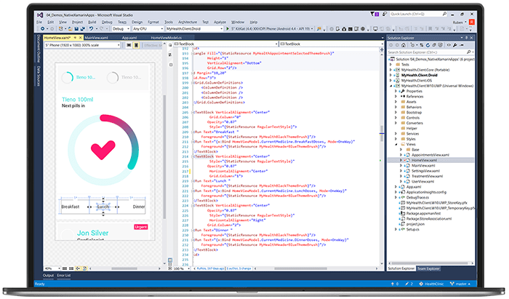
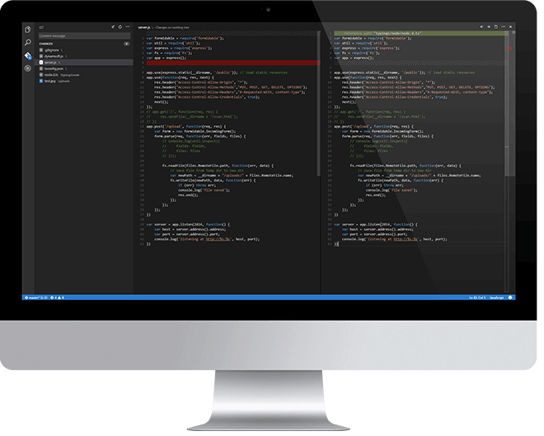
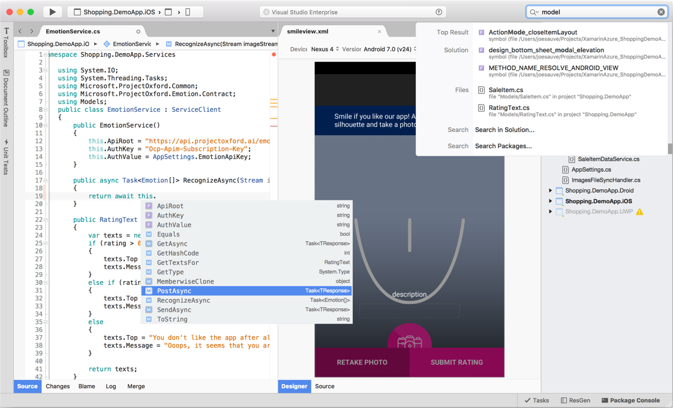
The development tools
Visual Studio 2015 or 2017 RC
Visual Studio Code
Visual Studio for Mac
Xamarin Studio
Notes:
This slide is required. Do NOT delete. This should be the first slide after your Title Slide. This is an important year and we need to arm our attendees with the information they can use to Grow Share! Please ensure that your objectives are SMART (defined below) and that they will enable them to go in and win against the competition to grow share. If you have questions, please contact your Track PM for guidance. We have also posted guidance on writing good objectives, out on the Speaker Portal (https://www.mytechready.com).
This slide should introduce the session by identifying how this information helps the attendee, partners and customers be more successful. Why is this content important?
This slide should call out what’s important about the session (sort of the why should we care, why is this important and how will it help our customers/partners be successful) as well as the key takeaways/objectives associated with the session. Call out what attendees will be able to execute on using the information gained in this session. What will they be able to walk away from this session and execute on with their customers.
Good Objectives should be SMART (specific, measurable, achievable, realistic, time-bound). Focus on the key takeaways and why this information is important to the attendee, our partners and our customers.
Each session has objectives defined and published on www.mytechready.com, please work with your Track PM to call these out here in the slide deck.
If you have questions, please contact your Track PM. See slide 5 in this template for a complete list of Tracks and TPMs.

Slide 22
The web story

Slide 23
Client side
The client side of a web application is what the user see and interacts with
It’s tipically delivered by a browser
Three main languages involved:
HTML: markup language based on XML to define the user interface
CSS: style sheet language to describe the presentation of a user interface written in HTML
JavaScript: dynamic and interpreted language that handles frontend logic, interaction, data validation, etc.
Notes:
This slide is required. Do NOT delete. This should be the first slide after your Title Slide. This is an important year and we need to arm our attendees with the information they can use to Grow Share! Please ensure that your objectives are SMART (defined below) and that they will enable them to go in and win against the competition to grow share. If you have questions, please contact your Track PM for guidance. We have also posted guidance on writing good objectives, out on the Speaker Portal (https://www.mytechready.com).
This slide should introduce the session by identifying how this information helps the attendee, partners and customers be more successful. Why is this content important?
This slide should call out what’s important about the session (sort of the why should we care, why is this important and how will it help our customers/partners be successful) as well as the key takeaways/objectives associated with the session. Call out what attendees will be able to execute on using the information gained in this session. What will they be able to walk away from this session and execute on with their customers.
Good Objectives should be SMART (specific, measurable, achievable, realistic, time-bound). Focus on the key takeaways and why this information is important to the attendee, our partners and our customers.
Each session has objectives defined and published on www.mytechready.com, please work with your Track PM to call these out here in the slide deck.
If you have questions, please contact your Track PM. See slide 5 in this template for a complete list of Tracks and TPMs.

Slide 24
Frameworks and supersets
Web applications are becoming more and more complex day by day
Third party frameworks and supersets of the language help to ease the pain
Some examples: AngularJS, Aurelia, jQuery, TypeScript, etc.
Notes:
This slide is required. Do NOT delete. This should be the first slide after your Title Slide. This is an important year and we need to arm our attendees with the information they can use to Grow Share! Please ensure that your objectives are SMART (defined below) and that they will enable them to go in and win against the competition to grow share. If you have questions, please contact your Track PM for guidance. We have also posted guidance on writing good objectives, out on the Speaker Portal (https://www.mytechready.com).
This slide should introduce the session by identifying how this information helps the attendee, partners and customers be more successful. Why is this content important?
This slide should call out what’s important about the session (sort of the why should we care, why is this important and how will it help our customers/partners be successful) as well as the key takeaways/objectives associated with the session. Call out what attendees will be able to execute on using the information gained in this session. What will they be able to walk away from this session and execute on with their customers.
Good Objectives should be SMART (specific, measurable, achievable, realistic, time-bound). Focus on the key takeaways and why this information is important to the attendee, our partners and our customers.
Each session has objectives defined and published on www.mytechready.com, please work with your Track PM to call these out here in the slide deck.
If you have questions, please contact your Track PM. See slide 5 in this template for a complete list of Tracks and TPMs.

Slide 25
ASP.NET
Framework to create server side based apps (web apps, REST services, etc.)
All the current investments are made in the MVC version of the platform, which leverages the Model-View-Controller pattern
It relies on the full .NET Framework and, consequently, it’s tight to Windows: it runs only on IIS on Windows or Windows Server
Notes:
This slide is required. Do NOT delete. This should be the first slide after your Title Slide. This is an important year and we need to arm our attendees with the information they can use to Grow Share! Please ensure that your objectives are SMART (defined below) and that they will enable them to go in and win against the competition to grow share. If you have questions, please contact your Track PM for guidance. We have also posted guidance on writing good objectives, out on the Speaker Portal (https://www.mytechready.com).
This slide should introduce the session by identifying how this information helps the attendee, partners and customers be more successful. Why is this content important?
This slide should call out what’s important about the session (sort of the why should we care, why is this important and how will it help our customers/partners be successful) as well as the key takeaways/objectives associated with the session. Call out what attendees will be able to execute on using the information gained in this session. What will they be able to walk away from this session and execute on with their customers.
Good Objectives should be SMART (specific, measurable, achievable, realistic, time-bound). Focus on the key takeaways and why this information is important to the attendee, our partners and our customers.
Each session has objectives defined and published on www.mytechready.com, please work with your Track PM to call these out here in the slide deck.
If you have questions, please contact your Track PM. See slide 5 in this template for a complete list of Tracks and TPMs.

Slide 26
ASP.NET
It’s the most mature platform
It supports multiple development approaches (Web Pages, Web Forms, MVC, etc.)
Support for SignalR to implement real-time communication scenarios
Support for WCF to create services
Wide choice of third party libraries on NuGet
Develop using Visual Studio in C#, F# and VB.NET
Notes:
This slide is required. Do NOT delete. This should be the first slide after your Title Slide. This is an important year and we need to arm our attendees with the information they can use to Grow Share! Please ensure that your objectives are SMART (defined below) and that they will enable them to go in and win against the competition to grow share. If you have questions, please contact your Track PM for guidance. We have also posted guidance on writing good objectives, out on the Speaker Portal (https://www.mytechready.com).
This slide should introduce the session by identifying how this information helps the attendee, partners and customers be more successful. Why is this content important?
This slide should call out what’s important about the session (sort of the why should we care, why is this important and how will it help our customers/partners be successful) as well as the key takeaways/objectives associated with the session. Call out what attendees will be able to execute on using the information gained in this session. What will they be able to walk away from this session and execute on with their customers.
Good Objectives should be SMART (specific, measurable, achievable, realistic, time-bound). Focus on the key takeaways and why this information is important to the attendee, our partners and our customers.
Each session has objectives defined and published on www.mytechready.com, please work with your Track PM to call these out here in the slide deck.
If you have questions, please contact your Track PM. See slide 5 in this template for a complete list of Tracks and TPMs.

Slide 27
ASP.NET Core
It’s cross platform and runs on Windows, Linux and Mac
It supports, at the moment, only MVC and Web API
New platform, so less mature and less features compared to ASP.NET at the moment
Develop using Visual Studio or Visual Studio Code and C#
It supports deploying side by side .NET versions per application level
Notes:
This slide is required. Do NOT delete. This should be the first slide after your Title Slide. This is an important year and we need to arm our attendees with the information they can use to Grow Share! Please ensure that your objectives are SMART (defined below) and that they will enable them to go in and win against the competition to grow share. If you have questions, please contact your Track PM for guidance. We have also posted guidance on writing good objectives, out on the Speaker Portal (https://www.mytechready.com).
This slide should introduce the session by identifying how this information helps the attendee, partners and customers be more successful. Why is this content important?
This slide should call out what’s important about the session (sort of the why should we care, why is this important and how will it help our customers/partners be successful) as well as the key takeaways/objectives associated with the session. Call out what attendees will be able to execute on using the information gained in this session. What will they be able to walk away from this session and execute on with their customers.
Good Objectives should be SMART (specific, measurable, achievable, realistic, time-bound). Focus on the key takeaways and why this information is important to the attendee, our partners and our customers.
Each session has objectives defined and published on www.mytechready.com, please work with your Track PM to call these out here in the slide deck.
If you have questions, please contact your Track PM. See slide 5 in this template for a complete list of Tracks and TPMs.

Slide 28

ASP.NET Core
Due to it’s lightweight and flexibility, it’s best used for:
High performance and scalable systems
Microservices architectures
Containers
Notes:
This slide is required. Do NOT delete. This should be the first slide after your Title Slide. This is an important year and we need to arm our attendees with the information they can use to Grow Share! Please ensure that your objectives are SMART (defined below) and that they will enable them to go in and win against the competition to grow share. If you have questions, please contact your Track PM for guidance. We have also posted guidance on writing good objectives, out on the Speaker Portal (https://www.mytechready.com).
This slide should introduce the session by identifying how this information helps the attendee, partners and customers be more successful. Why is this content important?
This slide should call out what’s important about the session (sort of the why should we care, why is this important and how will it help our customers/partners be successful) as well as the key takeaways/objectives associated with the session. Call out what attendees will be able to execute on using the information gained in this session. What will they be able to walk away from this session and execute on with their customers.
Good Objectives should be SMART (specific, measurable, achievable, realistic, time-bound). Focus on the key takeaways and why this information is important to the attendee, our partners and our customers.
Each session has objectives defined and published on www.mytechready.com, please work with your Track PM to call these out here in the slide deck.
If you have questions, please contact your Track PM. See slide 5 in this template for a complete list of Tracks and TPMs.

Slide 29
And what if I don’t want to use ASP.NET?
There are multiple technologies to create server side web applications and services, like:
Node.js
Ruby on Rails
Python
Java
Say hello to Microsoft Azure!
Notes:
This slide is required. Do NOT delete. This should be the first slide after your Title Slide. This is an important year and we need to arm our attendees with the information they can use to Grow Share! Please ensure that your objectives are SMART (defined below) and that they will enable them to go in and win against the competition to grow share. If you have questions, please contact your Track PM for guidance. We have also posted guidance on writing good objectives, out on the Speaker Portal (https://www.mytechready.com).
This slide should introduce the session by identifying how this information helps the attendee, partners and customers be more successful. Why is this content important?
This slide should call out what’s important about the session (sort of the why should we care, why is this important and how will it help our customers/partners be successful) as well as the key takeaways/objectives associated with the session. Call out what attendees will be able to execute on using the information gained in this session. What will they be able to walk away from this session and execute on with their customers.
Good Objectives should be SMART (specific, measurable, achievable, realistic, time-bound). Focus on the key takeaways and why this information is important to the attendee, our partners and our customers.
Each session has objectives defined and published on www.mytechready.com, please work with your Track PM to call these out here in the slide deck.
If you have questions, please contact your Track PM. See slide 5 in this template for a complete list of Tracks and TPMs.

Slide 30



















































Platform Services
Security & Management
Hybrid Operations
Compute
App Platform
Developer Services
Portal
Azure AD
Connect Health
Cloud
Services
Service
Fabric
Web Apps
API
Apps
API
Management
Visual Studio
Azure SDK
Active
Directory
Mobile
Apps
Logic
Apps
Notification
Hubs
AD Privileged
Identity Mngt
Batch
Remote App
Team Project
Application
Insights
Multi-Factor
Authentication
Backup
Integration
Analytics & IoT
Data
Automation
Storage
Queues
Biztalk
Services
Operational
Insights
HDInsight
Machine
Learning
SQL
Database
SQL Data
Warehouse
Key Vault
Hybrid
Connections
Service
Bus
Import/Export
Data
Factory
Event
Hubs
Redis
Cache
Search
Store /
Marketplace
Media & CDN
Site
Recovery
Stream
Analytics
Mobile
Engagement
DocumentDB
Tables
Media
Services
Content Delivery
Network (CDN)
VM Image Gallery
& VM Depot
StorSimple
Infrastructure Services
Compute
Storage
Networking
Windows
Linux
Containers
BLOB Storage
Azure Files
Premium Storage
Virtual Network
Load Balancer
DNS
Express
Route
Traffic Manager
VPN Gateway
Application Gateway
Notes:
Some conceptual higher level detail than the building block slide but something that will make the building block slide detail make sense… point is to somehow show that Azure is a broad and deep platform and most importantly it covers IaaS and PaaS… and to differentiate these things because that’s a big differentiator for us

Slide 31
App Services in Azure
It’s a set of service to support web, mobile and client apps which offers advanced features like:
Load balancing
Automatic scaling based on traffic
Authentication and security
Offline synchronization of data
Notes:
This slide is required. Do NOT delete. This should be the first slide after your Title Slide. This is an important year and we need to arm our attendees with the information they can use to Grow Share! Please ensure that your objectives are SMART (defined below) and that they will enable them to go in and win against the competition to grow share. If you have questions, please contact your Track PM for guidance. We have also posted guidance on writing good objectives, out on the Speaker Portal (https://www.mytechready.com).
This slide should introduce the session by identifying how this information helps the attendee, partners and customers be more successful. Why is this content important?
This slide should call out what’s important about the session (sort of the why should we care, why is this important and how will it help our customers/partners be successful) as well as the key takeaways/objectives associated with the session. Call out what attendees will be able to execute on using the information gained in this session. What will they be able to walk away from this session and execute on with their customers.
Good Objectives should be SMART (specific, measurable, achievable, realistic, time-bound). Focus on the key takeaways and why this information is important to the attendee, our partners and our customers.
Each session has objectives defined and published on www.mytechready.com, please work with your Track PM to call these out here in the slide deck.
If you have questions, please contact your Track PM. See slide 5 in this template for a complete list of Tracks and TPMs.

Slide 32
The mobile story

Slide 33
Cross-platform mobile strategy choices
Notes:
IMPORTANT: This deck is not about cross-platform mobile development options, is about cross-platform mobile development with XAMARIN. Assumes that:
the customer would get benefits with a c#/.NET approach, rather than a web mobile/hybrid/c++ native approach. All these scenarios are supported by Visual Studio, but for teams or companies with .NET investments/teams/skills the Visual Studio + Xamarin scenario will be more likely to be the preferred one.

Slide 34
Sweet spot for the successful mobile enterprise
End user
experience
Great apps delivered to the user’s choice of device
+
Development agility to move at mobile speed
-
+
Better TCO, productivity, and developer experience

Slide 35
the “Silo’ed” approach
iOS
Android
Windows
Objective-C, Swift
Xcode
Java
Android Studio
C#
Visual Studio

Slide 36

Silo’ed approach
Objective-C, Swift
XCode
Building native apps multiple times means
Client development is completely different for each device type
Only the Services (server-side) can be reused, with certain differences when consuming them
TCO grows exponentially
Java
Eclipse
C#, JS, C++
Visual Studio

Slide 37
The Silo’ed approach Multiple teams and multiple code bases are expensive and slow
End user
experience
+
-
+
Better TCO, productivity, and developer experience

Slide 38
The Silo’ed approach Multiple teams and multiple code bases are expensive and slow
End user
experience
Great apps delivered to the user’s choice of device
+
Development agility hampered by multiple code bases and fragment toolsets
-
+
Better TCO, productivity, and developer experience

Slide 39
Hybrid Approach
Lua
Javascript
Actionscript
HTML+CSS
App Generator
Notes:
Write once, run anywhere. Write an app in Javascript, HTML5, etc. and throw it into a “black box” app generator. Out spits an app for three platforms.
Problems?
Limited native API access. Forget about the latest and greatest, you can’t even add some basic platform-specific functionalities to your app like NFC
Slow performance (the app isn’t native)
Poor UX (the app doesn’t feel native to each platform)
Has all the issues we talked about earlier when we talked about “what is native”
Results in:
Unhappy users
Unhappy developers
Increase in abandoned apps

Slide 40
Hybrid approach
CSS • HTML • TypeScript • JavaScript • Ionic • …
Write-once-run-anywhere
box
Hybrid apps. Presentation written in HTML/CSS and behavior written in JavaScript/TypeScript
Highest code reuse ratio at UI expense
Performance depends on the container
Apache Cordova/Ionic

Slide 41
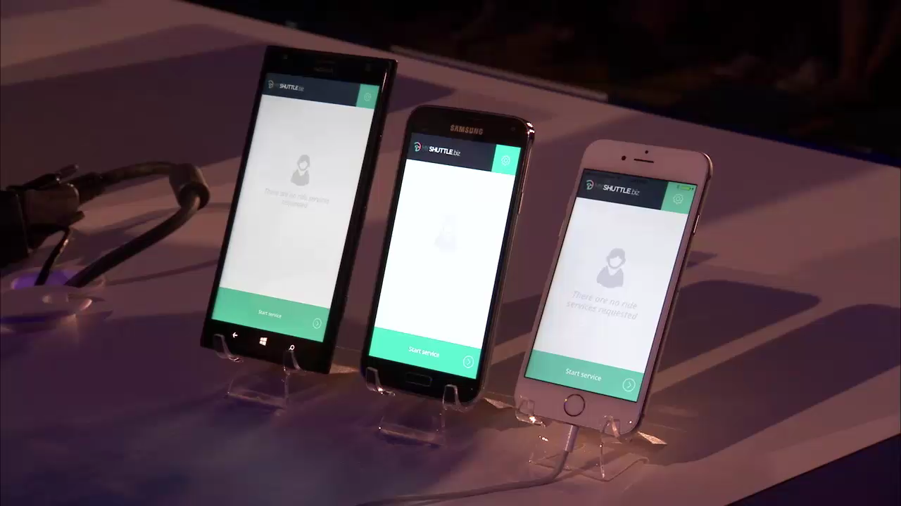

Slide 42
The write-once-run-anywhere approach HTML Hybrid scenarios like Apache Cordova
End user
experience
+
-
+
Better TCO, productivity, and developer experience

Slide 43
The write-once-run-anywhere approach HTML Hybrid scenarios like Apache Cordova
End user
experience
+
Performance tradeoff
Great option for teams with HTML5 web skills. Tooling maturity
-
+
Better TCO, productivity, and developer experience

Slide 44
Xamarin Approach
iOS C# UI
Android C# UI
Windows C# UI
Shared C# Business Logic (Portable Class Library)
Shared C# codebase • 100% native API access • High performance

Slide 45
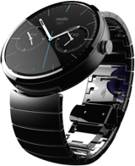
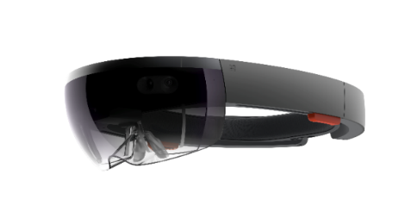
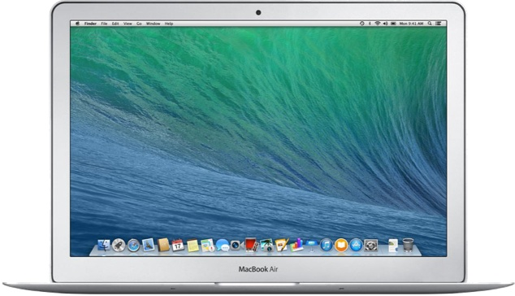

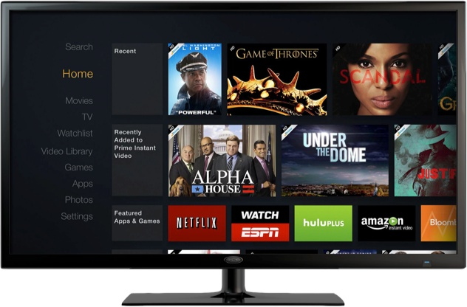
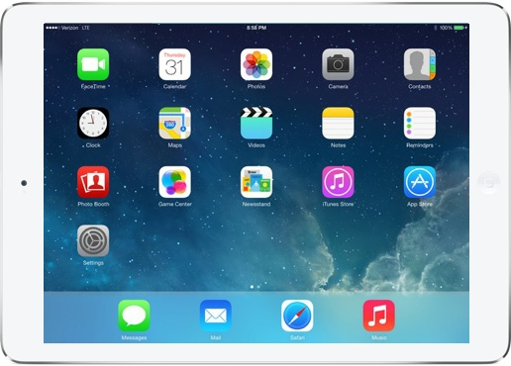
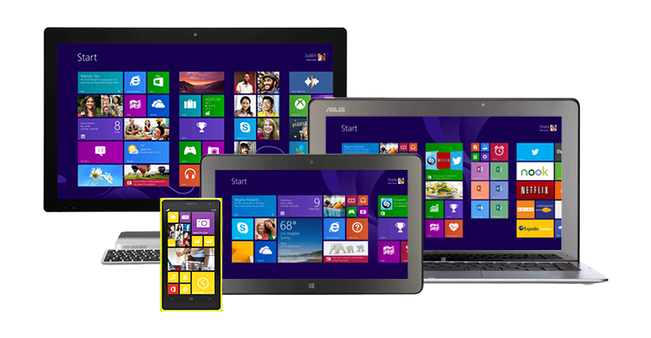
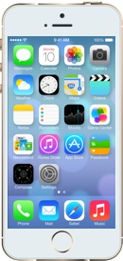
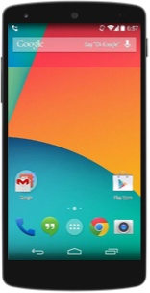
Xamarin Approach
iOS C# UI
Android C# UI
Windows C# UI
Shared C# Business Logic (Portable Class Library)
Shared C# codebase • 100% native API access • High performance
Watch
Android Wear
Microsoft Band

Slide 46
Xamarin Approach
iOS C# UI
Android C# UI
Windows C# UI
Shared C# Business Logic (Portable Class Library)
Shared C# codebase • 100% native API access • High performance

Slide 47
Xamarin Approach (Forms)
Shared C# UI (XML)
Shared C# Business Logic (Portable Class Library)
Shared C# codebase • 100% native API access • High performance

Slide 48
Xamarin approach
iOS
iOS C# UI
Android C# UI
Windows C# UI
Fully native apps written entirely in C#
Build apps with beautiful UX and native performance for Android, iOS & Windows
Be productive with templates, Intellisense, debugger, designer integration, emulators, deployment
Code share with PCLs
Create specific UI or share UI with Xamarin.Forms
Use C# APIs with 100% of platform APIs exposed
Connect to Azure for backend enterprise systems
Xamarin.Forms
Shared App Logic
Platform Specific Framework

Slide 49
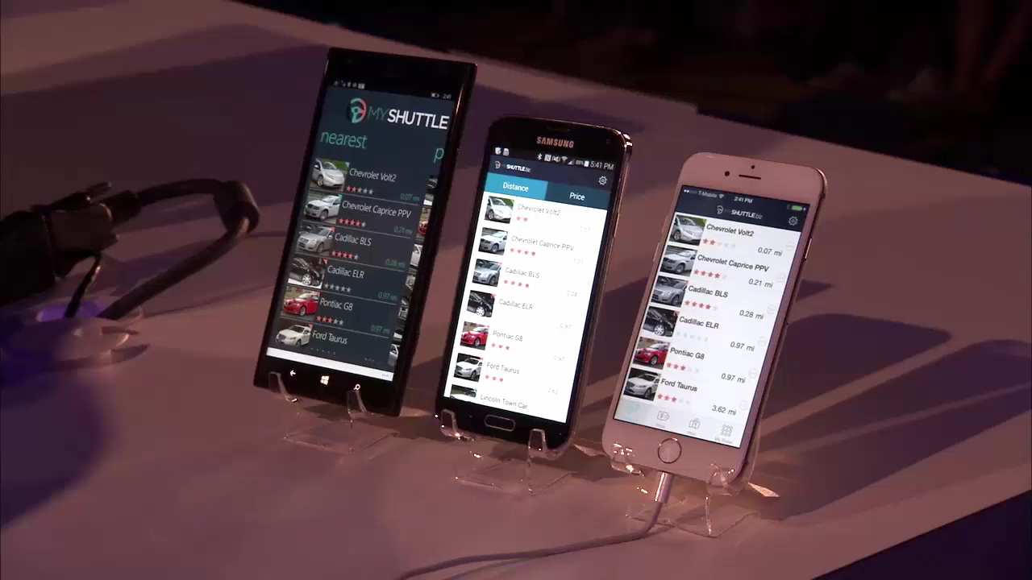

Slide 50
Visual Studio and Xamarin unique approach The best of all worlds
C#
End user
experience
Native performance and UI
+
Mature development tools
Share and reuse code
-
+
Better TCO, productivity, and developer experience

Slide 51
Maximizing Sharing Capabilities
iOS Watch Mac
Android Android Wear
Universal Windows Platform
Windows Backend Cloud or OnPrem
Linux Backend Cloud or OnPrem
Shared C# Mobile
C# Server
Shared C# Client/Server

Slide 52
Maximizing Sharing Capabilities
iOS Watch Mac
Android Android Wear
Universal Windows Platform
Windows Backend Cloud or OnPrem
Linux Backend Cloud or OnPrem
Shared C# Mobile
C# Server
Shared C# Client/Server

Slide 53
Maximizing Sharing Capabilities
iOS Watch Mac
Android Android Wear
Universal Windows Platform
Windows Backend Cloud or OnPrem
Linux Backend Cloud or OnPrem
Shared C# Mobile
C# Server
Shared C# Client/Server

Slide 54
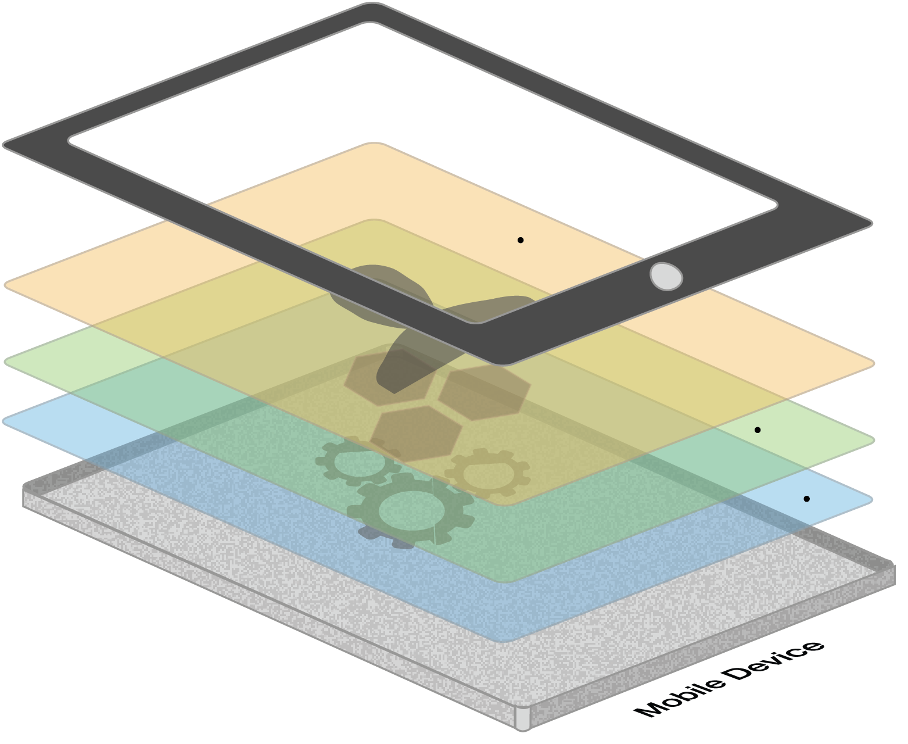



Xamarin is native in all 3 ways The best of all worlds
Native user interface
Apps are built with standard, native user interface controls for easy and familiar interactions
High-fidelity API access
Apps have access to the full spectrum of functionality exposed by the underlying platform and device
Native performance
Apps leverage platform-specific hardware acceleration, and are compiled as native binaries, not interpreted at runtime

Slide 55
Same-day support:
iOS 5
iOS 6
iOS 7
iOS 7.1
iOS 8
iOS 9
iOS 10
Full support for:
Apple Watch
Google Glass
Android Wear
Amazon Fire TV
And much more
Always up-to-date
Notes:
Apple has a developer preview where Xamarin has alphas ready. Google does not offer this.
Android versions are usually 4 to 8 weeks out for a stable release, but alphas and betas are usually earlier.
Xamarin realizes how important having iOS ready because within 24 hours a large portion of iOS users upgrade
Android on the other hand is much different. After 4 months on the market Android 4.4 only had 1% adoption

Slide 56
Anything you can do in Objective-C, Swift, or Java; can be done in C#

Slide 57
The Xamarin SDK
Notes:
The Xamarin Runtime is the piece that enables Xamarin applications on different devices.

Slide 58
Visual Studio… now with Xamarin
Visual Studio Community
Tools for non-Enterprise scenarios
Key scenarios
Hobbyists, students, OSS, small teams
Create applications for Android, iOS, and Windows
Runs on Windows
Share code across devices
Debugging code
Key IDE features
Build (incl. remote Mac agent)
Native designers
Debugger
Xamarin.Forms
New Dev Essentials benefits
Access to recorded Xamarin University classes
Xamarin Studio Community
Tools for non-Enterprise scenarios
Key scenarios
Hobbyists, students, OSS, small teams
Create applications for Android and iOS
Runs on OS X
Share code across devices
Debugging code
Key IDE features
Build (incl. remote Mac agent)
Native designers
Debugger
Xamarin.Forms
New Dev Essentials benefits
Access to recorded Xamarin University classes
Visual Studio Professional
Tools for individual developer and small team productivity
Key scenarios
Unrestricted, professional mobile development, code sharing, and debugging
Key IDE features
No usage restrictions for Visual Studio
No usage restrictions for Xamarin Studio
New subscription benefit
Access to advanced content on Xamarin University
Visual Studio Enterprise
Enterprise grade tools for projects of any size and complexity
Key scenarios
Productivity for enterprise applications
Enterprise security
Enterprise quality
Key IDE features
Embedded Assemblies
Xamarin Inspector Preview
Xamarin Profiler Preview
Above enterprise features in Xamarin Studio
VSE features used for Xamarin
Xamarin Test Recorder – IDE Add-in [Roadmap]
New subscription benefit
25% Test Cloud discount
Notes:
In-house & store deployment possible in Community SKUs

Slide 59
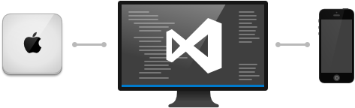
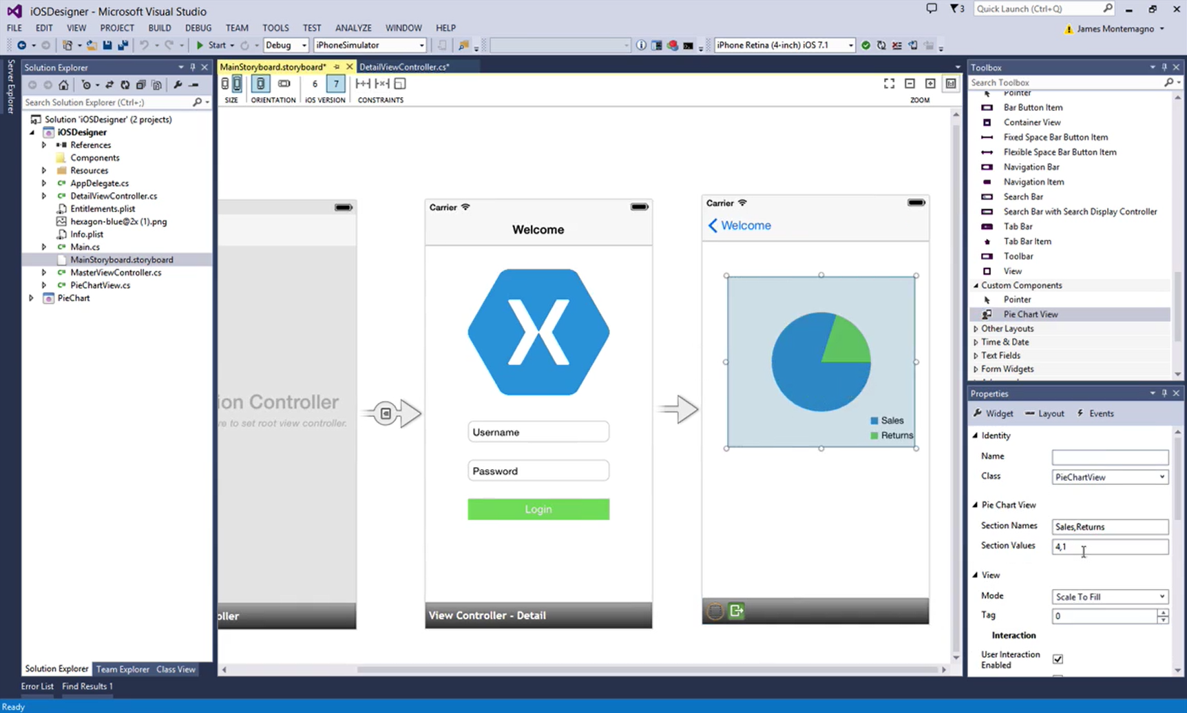
Xamarin and Visual Studio integration
A single solution for Android, iOS, and Windows development
Leverage the entire Microsoft ecosystem
Visual Studio Team Services (VSTS)
ReSharper
Your favorite code coverage and profiling tools

Slide 60
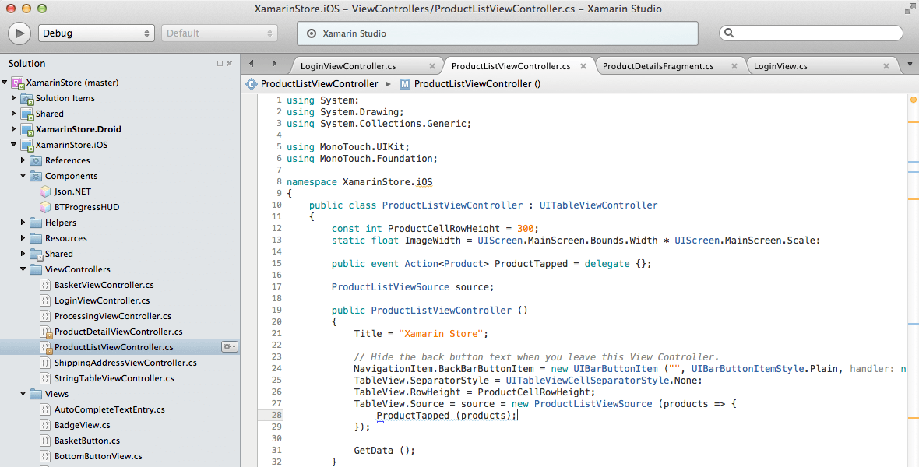
Xamarin Studio and Visual Studio for Mac – OS X
Notes:
IDEs on your favorite OS

Slide 61
Demo
A traditional Xamarin application
Notes:
Create a simple new Xamarin application with Visual Studio. Walk the audience through the project type and show it running on different platforms.
Idea: to demonstrate the difference in the UI, I’d recommend to show also an apache cordova app. There is a step by step howto on http://taco.visualstudio.com

Slide 62
Xamarin.Forms

Slide 63
Xamarin.Forms - What’s included
✓ 40+ Pages, layouts, and controls
(Build from code behind or XAML)
✓ Two-way data binding
✓ Navigation
✓ Animation API
✓ Dependency Service
✓ Messaging Center
Shared UI Code
Shared C# Backend
Notes:
What is included in Xamarin.Forms?
40+ pages, layouts, and controls to mix-and-match from
Build your apps using either C# or XAML
If you come from a Windows/WP background, you will love XAML! ☺
Two-way data binding
If you have used MVVM, you will feel right at home with Xamarin.Forms
Navigation, animation APIs
DepedencyService – access all the native APIs you please
MessagingCenter – for decoupled architectures
Xamarin.Forms is more than a library, it’s a complete framework to rapidly build apps.

Slide 64
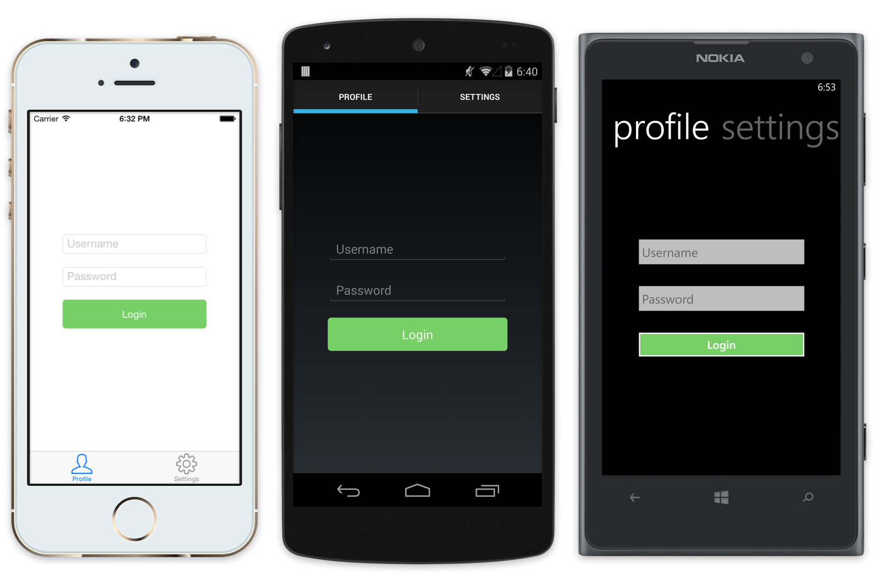
Xamarin.Forms
<?xml version="1.0" encoding="UTF-8"?>
<TabbedPage xmlns=“…" xmlns:x=“…“ x:Class="MyApp.MainPage">
<TabbedPage.Children>
<ContentPage.Title="Profile" Icon="Profile.png">
<StackLayout Spacing="20" Padding="20” VerticalOptions="Center">
<Entry Placeholder="Username" Text="{Binding Username}"/>
<Entry Placeholder="Password” Text="{Binding Password}” IsPassword="true"/>
<Button Text="Login" TextColor="White” BackgroundColor=”…” Command=”…"/>
</StackLayout>
</ContentPage>
<ContentPage Title="Settings"
Icon="Settings.png">
<!-- Settings -->
<</ContentPage>
</TabbedPage.Children>

Slide 65

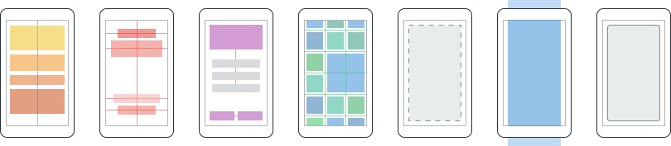
Layouts
Pages
Content
MasterDetail
Navigation
Tabbed
Carousel
Stack
Absolute
Relative
Grid
ContentView
ScrollView
Frame
Notes:
Pages are essentially a screen in your application. Many different options, from simple content pages to carousel pages.
To help organize your controls, there are layouts. From easy to use, managed layouts like StackLayout (where you just specify order of elements), to super powerful layouts like grids.

Slide 66
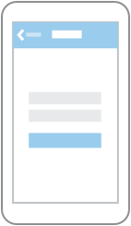
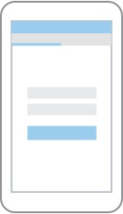

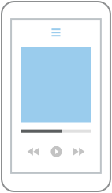
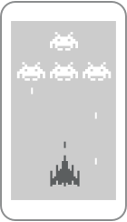

Which Xamarin approach is best for your app?
Xamarin.Forms is best for:
Xamarin.iOS / Xamarin.Android is best for:
Data entry apps
Prototypes and proofs-of-concept
Apps that require little platform-specific functionality
Apps where code sharing is more important than custom UI
Apps that require specialized interaction
Apps with highly polished design
Apps that use many platform-specific APIs
Apps where custom UI is more important than code sharing
Learn more: xamarin.com/forms
Learn more: xamarin.com/platform
Notes:
Xamarin.Forms is awesome, but it’s not right for every app!
In general: If you care most about code sharing, go with Xamarin.Forms. If you care most about custom UIs and using lots of platform-specific UIs, you should use Xamarin.iOS + Xamarin.Android.

Slide 67
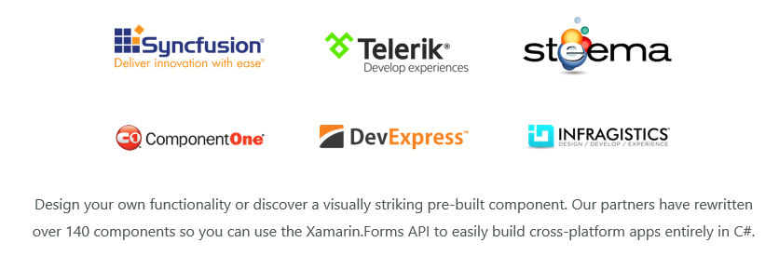
Xamarin.Forms Ecosystem
Video

Slide 68
Demo
Xamarin Forms application
Notes:
Create a simple new Xamarin application with Visual Studio. Walk the audience through the project type and show it running on different platforms.
Idea: to demonstrate the difference in the UI, I’d recommend to show also an apache cordova app. There is a step by step howto on http://taco.visualstudio.com

Slide 69
Xamarin Plugins

Slide 70
Platform Specific Code
UI+APIs
UI + APIs
UI + APIs
Battery
GPS
Lights
Notifications
Settings
Text To Speech
Battery
GPS
Lights
Notifications
Settings
Text To Speech
Battery
GPS
Lights
Notifications
Settings
Text To Speech
What if we didn’t have to write this code?
What if we could access it from shared code?
Notes:
Remember the dependency service from earlier? We can use that to access all the platform-specific features we want!

Slide 71
Plugins for Xamarin
github.com/xamarin/plugins
Common API
Notes:
Plugins for Xamarin are an easy way to add lots of platform-specific functionality to your app, without having to write the services to do so, such as:
Connectivity
Geolocation
Dialogs

Slide 72
Speak(“Hello World”);
AVSpeechSynthesizer
TextToSpeech
SpeechSynthesizer
Notes:
You can see here how a custom service with a method “Speak” would be mapped from shared to each platform’s speaking engine

Slide 73
The Windows story

Slide 74

Platform Convergence Journey
Xbox 360
Xbox One
Unified core and app platform
Converged
Operating System kernel
Windows 8
Windows 8.1
Converged
app model
Windows 10
Windows Phone 8.1
Windows Phone 8
Windows Phone 7.5
Windows on Devices
Notes:
Speaker Notes:
First, let us discuss a little bit of history and where do we come from.
----------------------------------------------------------------
Platform convergence has been a journey which ends today with Windows 10.
We started by bringing Internet Explorer to Windows Phone 7.5 and even Xbox 360. With the release of Windows 8, we laid the foundation with the windows kernel, drivers etc. Windows Phone 8 took advantage of this. Xbox One was built on top of Windows 8 and even used the same runtime so developer could write apps in HTML/WinJS the same framework as available on Windows 8.
With the release of Windows Phone 8.1, the runtimes from Windows 8.1 and phone came together as well. Over 90% API convergence and things like Windows Notification Services, sharing contracts, live tiles, etc. started to come together.
Our endpoint Threshold brings together everything, the foundation is the same, kernel, drivers, etc. The application platform is the same and we will go into a little bit more detail later in this presentation.
Background data:
September 15, 2011 - Windows Phone 7.5
October 26, 2012 - Windows 8
October 29, 2012 - Windows Phone 8
October 18, 2013 - Windows 8.1
November 22, 2013 - Xbox One
April 8, 2014 - Windows 8.1 Update
March 26, 2014 - Windows Phone 8.1
Purpose of this slide: Set the historic context that when we say “Threshold” we mean the converged platform.
We have about 1.5 billion devices. That is a lot of devices for developers to target. However, the 1.5 billion devices do not all have the same app model; some are XP, some are Xbox, some are phones, some are tablets, and some are servers. What language or platform do I choose? Microsoft Foundation Classes (MFC), or Windows Presentation Foundation (WPF), or SL or Windows RT.
Nothing shows “One Windows” more than the way our platforms are converging, a journey which ends with Windows “Threshold.”
With the release of Windows 8, we laid the foundation. You sometimes hear this referred to as OneCore.
Windows Phone 8 took advantage of this and Xbox One was built on top of Windows 8.
With the release of Windows Phone 8.1, the Windows RT runtimes from phone and desktop came together. Over 90% API convergence.
Threshold brings everything together, the foundation is the same, kernel, drivers etc. – from computers to phones, to IoT devices.
The application platform is the same across all of these devices. Seems incomplete – kindly elaborate on the context for clarity.
[EDITOR] Shiron
Date formats have been modified for clarity. Please validate if they are correct.
Original:
• 9/15/11 Windows Phone 7.5
• 10/26/12 Windows 8
• 10/29/12 Windows Phone 8
• 10/18/13 Windows 8.1
• 11/22/13 Xbox One
• 4/8/14 Windows 8.1 Update
• 3/26/14 Windows Phone 8.1

Slide 75

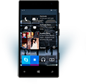

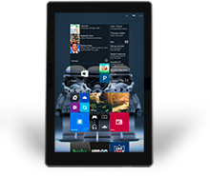
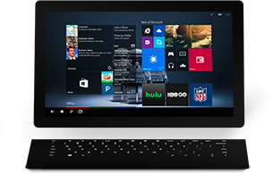
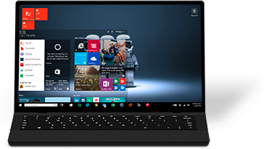

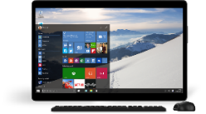
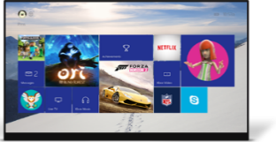
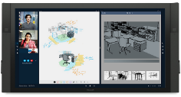
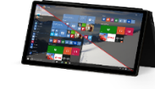
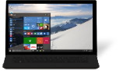
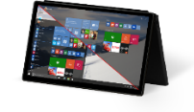
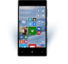
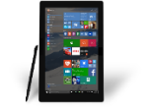
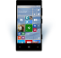

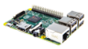
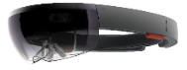
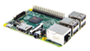







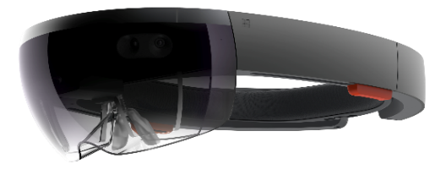
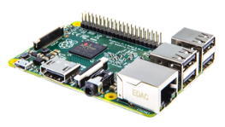
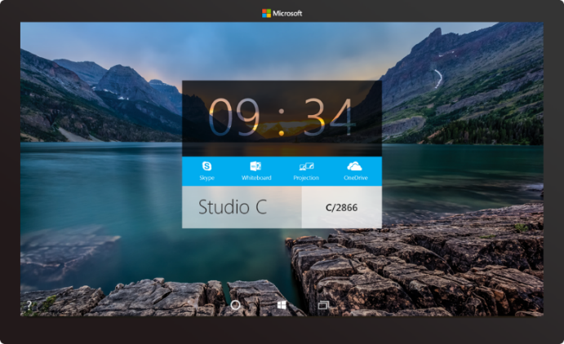



PC
Xbox
Mobile
Surface Hub
Devices +IoT
HoloLens
Universal Windows Apps
Multiple device families
Adaptive User Interface
Reuse Existing Code
Natural User Inputs
One Store + One Dev Center
One SDK + Tooling
One Universal Windows Platform

Slide 76
Universal Windows Platform (UWP)

Slide 77
Windows Core
The refactored common core
One hardware platform
Universal hardware driver
Standard network and I/O
Desktop SKU
Phone SKU
Xbox SKU
Windows Core
Desktop
Device
Phone
Device
Xbox
Device
Notes:
Windows Core maps to the kernel that is optimized to run on any devices.

Slide 78
One Windows
Desktop SKU
Mobile SKU
Xbox SKU
IoT SKU
IoT headless SKU
Surface Hub SKU
Holographic SKU
PC
Two-in-one
Tablet
Phablet
Phone
Xbox
Band
Raspberry Pi
Surface Hub
HoloLens
Home Automation
Notes:
Stock Keeping Units (SKUs) are the different “marketing” versions and below the corresponding devices.

Slide 79
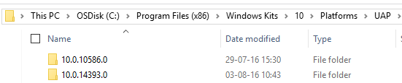
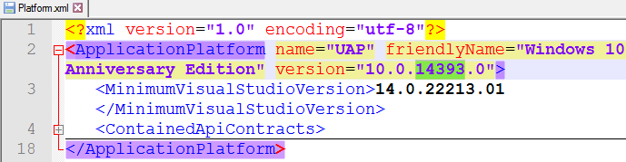
Universal Windows Platform
A single API surface
A guaranteed API surface
The same on all devices
Universal Windows Platform
Windows Core
Desktop
Device
Phone
Device
Xbox
Device
Notes:
Speaker Notes:
Demo: Show where this is stored.
---------------------------------
Go to C:\Program Files (x86)\Windows Kits\10\Platforms\UAP\ and select highest API version installed
Click the platform.xml file.
Go to C:\Program Files (x86)\Windows Kits\10\References\ and look for Windows.Foundation.UniversalApiContract and the two other .winmd files.
Open the files in ILspy.
Windows.Foundation.UniversalApiContract is the former Windows RT APIs and new Windows 10 APIs.
DEMO: use WinMDdiff tool to show the differences between versions of Win10/Anniversary Update folders in Demos\Win10Metadata\
[EDITOR] Deepankar Panda (Spectrum Consultants India Pvt):
06 October 2015 Seems ambiguous – Kindly elaborate on the context for clarity.
[EDITOR] Deepankar Panda (Spectrum Consultants India Pvt):
06 October 2015 Seems incomplete – Kindly elaborate on the content for clarity.

Slide 80
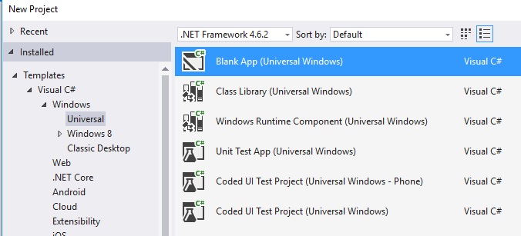
Windows App
A single binary
Running on any device
Testing for capabilities
Adjusting to devices
Windows App
Universal Windows Platform
Windows Core
Desktop
Device
Phone
Device
Xbox
Device

Slide 81
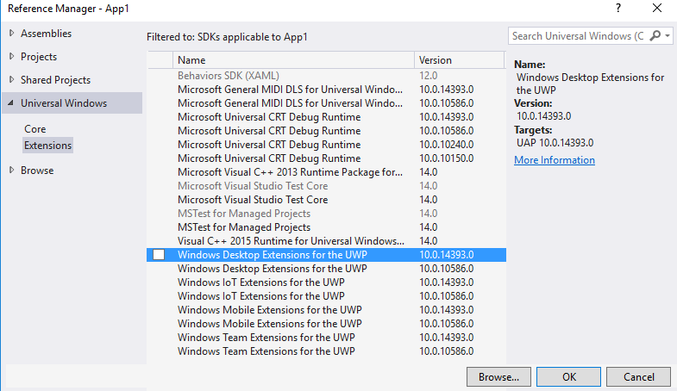
Platform Extensions
Device-specific API
Family-specific capabilities
Compatible across devices
Unique update cadence
Windows App
Desktop
extension
Phone
extension
Xbox
extension
Universal Windows Platform
Windows Core
Desktop
Device
Phone
Device
Xbox
Device

Slide 82
Extension SDKs
UWP
UWP
UWP
UWP
Windows Core
Windows Core
Windows Core
Windows Core
Desktop
Mobile
Xbox
More…
Notes:
This is a visual and animated summary of what we are trying to achieve with UAP:^)
Note: The empty areas are just empty stubs that will throw exceptions if not there on the device. However, you can still compile your app into one single binary.
They could also return null instead of exception.
Example: For printer on Xbox, the default printer will be null.
[EDITOR] Deepankar Panda (Spectrum Consultants India Pvt):
06 October 2015 UAP:^ seems ambiguous – kindly see.
[EDITOR] Deepankar Panda (Spectrum Consultants India Pvt):
06 October 2015 Please fill in the missing information for clarity: “if _________ is/are not there on the device”

Slide 83
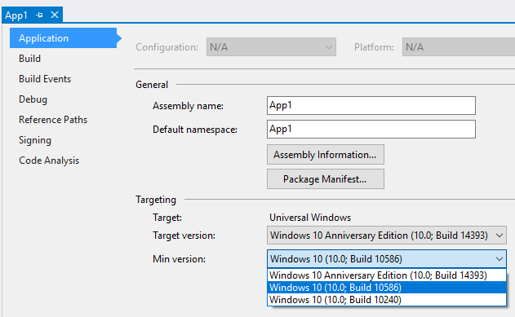
Project Properties
Min version (TargetPlatformMinVersion)
Defines the minimum version of Universal Windows platform being supported by the project (adaptive application package)
Is stamped as TargetDeviceFamily.MinVersion property in the AppX manifest as part of the build process
<Dependencies>
<TargetDeviceFamily
Name="Windows.Universal" MinVersion="10.0.10240.0" MaxVersionTested="10.0.14393.0" />
</Dependencies>
Notes:
Target version
There will be more versions of Windows RT after some time in Windows 10.
Newer versions will have more features.
There is a concept of quirking. If a feature changes in a later version of an API, the Windows RT will shim that API for backwards compatibility and it will go off the target version.
Minimum version
Minimum version of the Windows Runtime that the app needs.
Recommendation is to keep this as low as possible to maximize exposure.
Store will filter apps shown to end user based on the Windows RT version.
Target version should be as high as possible to benefit from all features (can you use API-information?).
[EDITOR] Deepankar Panda (Spectrum Consultants India Pvt):
06 October 2015 Is it referring to “Visual Studio 2015 RTM” and can be changed accordingly? – Kindly verify.
[EDITOR] Deepankar Panda (Spectrum Consultants India Pvt):
06 October 2015 Please validate the question in the brackets.
[EDITOR] Shiron Antony:
06 October 2015 Please validate the use of the term “quirk”. Consider replacing it with a more technical term if possible and required.

Slide 84
Windows Device Family Extension SDKs
Use device family specific APIs by adding references to Windows Device Family Extension SDKs
Notes:
Specific API (for example, hardware button on phone)
These extension Software Development Kit (SDK) are also containing all UWP

Slide 85
Testing for Capabilities
Windows.Foundation.Metadata.ApiInformation
IsApiContractPresent
IsEnumNamedValuePresent
IsEventPresent
IsMethodPresent
IsPropertyPresent
IsReadOnlyPropertyPresent
IsTypePresent
IsWriteablePropertyPresent
Notes:
These tests are done at runtime with the ApiInformation methods.
All types are associated to “Contracts” (not the same as Share “contract”). These contracts are a consistent unit of features that are assumed to be all implemented or not implemented at all. The UWP and the SDK extensions are implementing contracts (see slide 17 to know where these lists of contracts are defined in the SDK).
This association type/contract is done via the ContractVersionAttribute
[ContractVersion(typeof(DevicesLowLevelContract), 65536u), …] public sealed class GpioController : IGpioController
Note: Use IsApiContractPresent when you need to use several types of the same contract to avoid many calls to IsTypePresent.

Slide 86
Test Capabilities at Runtime
Use Adaptive Code to light-up your app on specific devices
var api = "Windows.Phone.UI.Input.HardwareButtons";
if (Windows.Foundation.Metadata.ApiInformation.IsTypePresent(api))
{
Windows.Phone.UI.Input.HardwareButtons.CameraPressed += CameraButtonPressed;
}
Notes:
Do not use typeof(Windows.Phone.UI.Input.HardwareButtons).ToString() that “Windows.Phone.UI.Input.HardwareButtons” because it would raise an exception on a platform where the API is not implemented.

Slide 87
WPF
Win-Forms
MFC
XAML
DirectX
HTML
Bridging technologies
Obj.C
iOS
Web
hosted
Win32
desktop
C# and VB
C++
C# & VB
C++
& CX
WWA
.Net
runtime
Universal Windows Platform
Windows 10
operating system
Notes:
XAML and C#/C++ technologies are not the only way to create Windows apps
→ It is possible to go to UWP from iOS Objective-C code, HTML/JS web sites and Win32/.NET applications

Slide 88
Classic desktop apps
Based on the Windows APIs (Win32) included in Windows
They are available only in the full edition of Windows for PC and tablets
They can be developed with multiple technologies and platforms, including non-Microsoft ones:
Windows Forms
WPF
C++
Java
Delphi
And many more…

Slide 89

User experience challenges today
Getting the right software
Finding the right, trusted installer
Chain-installers (adware)
Staying up-to-date
Doing a clean uninstall
Notes:
Today, users on the desktop are facing some challenges compared to the experience they have on other platforms, like mobile:
There isn’t a centralized point of distribution like a Store. Users have to find the right website on the web and make sure to download the right and trusted installers. Many malicious developers, in fact, leverages famous app names to distribute fake versions of the app which are, in reality, malwares or virus.
The lack of a centralized point of distribution makes also harder to stay always up-to-date with the latest version of the application, since not all the desktop applications offer a built-in auto update feature.
Since many desktop applications uses techniques like writing keys in the registry or creating files in public folders to share info with other applications, you may end up with many leftovers after you have uninstalled the app that are useless and that can slow down, time over time, your computer.

Slide 90

Software vendor challenges today
Development and maintenance
Maintaining installer tech
Providing auto-updates
“DLL Hell”
Modernization
Trustworthy distribution
Monetization/licensing
Notes:
Not just users, but also developers and software vendors are facing new challenges today:
Developing and maintaining an application has become complex, because users expect frequent updates but, without a centralized distribution system, it’s up to the developer to create all the needed infrastructure to handle patching, updates, etc.
Due to the mobile revolutions, customers are more and more used to leverage new and more modern interfaces and way to interact with applications: touch screen interfaces, push notifications, etc. Supporting these scenarios in traditional desktop applications is challenging, because you have to rely on third party solutions or create your own infrastructure / tools / controls.
Developers want to create a trusted relationship with your customers and having fake copies of your application that are, instead, malware or virus is the worst advertising a software vendor can get.
Again, due to the lack of a centralized distribution system like on mobile, it’s up to the vendor to create the needed infrastructure to sell its software: they need to setup a Paypal or banking account, integrate the payment APIs on their website, handle the transaction and the required license keys to unlock the software, etc.

Slide 91
The value of the Desktop Bridge
Simplified and trusted deployment
Clean and simple install/uninstall
Updates delivered using differential packages
Greater reach, easier monetization
Windows Store reaches 400+ million users today
Built-in support for trials and paid add-ons
Advanced distribution features, like flighting and gradual rollout
Windows Store for Business, MDM tools, System Center, manual deployment, etc. for business customers
Modernizing with UWP
Add UWP capabilities (Live Tiles, push notifications, in-app purchase, XAML UI) and migrate at your own pace

Slide 92

The conversion journey

Slide 93

Convert
Desktop App Converter
Any installer, not just MSI
Silent installer required
Manual packaging
Create manifest file
Add executable and DLLs
Add assets (images, file associations, etc.)
Manually create the AppX
Supported tools
InstallShield, Wix, Advanced Installer, Electron Windows Store (GitHub), RadStudio Berlin

Slide 94
Demo A converted app

Slide 95

Enhance
Feature Examples
Live Tile support
Notifications
Cortana
Hello
Ink
Integration with the monetization options offered by the Store (trial, add-ons, etc.)

Slide 96

Extend
Feature Examples
XAML UI front end
App services
Background tasks
Launch for results
Runs in App Container process

Slide 97

Migrate
Feature Examples
Move UWP compatible code / components in the App Container process
When the UWP app is executed on a desktop, it can launch a Win32 process and communicate with it using an App Service

Slide 98

Reach all
Move all code to UWP
Migrate your legacy code to the new modern approach
The Windows team is committed into making UWP a first class citizen for desktop apps, so expect more and more desktop APIs and features in the next updates of Windows 10

Slide 99
Publishing on the Store
Not currently available for every developer for security and legal reasons
You can nominate your app at https://aka.ms/bridgenomination
A Microsoft engineer will work with you to solve technical blockers and to grant the access to the required special capability, called runFullTrust

Slide 100
References
Documentation: http://docs.microsoft.com
Xamarin samples: https://github.com/qmatteoq/XamarinSamples
Desktop Bridge samples: https://github.com/qmatteoq/DesktopBridge

Slide 101
Matteo Pagani
Windows AppConsult Engineer
matteo.pagani@microsoft.com
Twitter: @qmatteoq

